Slide 1
Policies to Eliminate Private Property Abandonment in the United States for 52nd International Making Cities Livable Conference Bristol, United Kingdom June 29 – July 3, 2015
Rex LaMore Ph.D.
Mengqiu Wu MSU MURP
Center for Community and Economic Development
Michigan State University

Slide 2
Overview
In this session we will:
Examine the nature and scope of private property abandonment
Discuss the social, economic and environmental consequences associated with abandonment
Proposes innovative policies and practices for removal of abandoned private structures
Explore alternative approaches to change our built environment paradigm

Slide 3
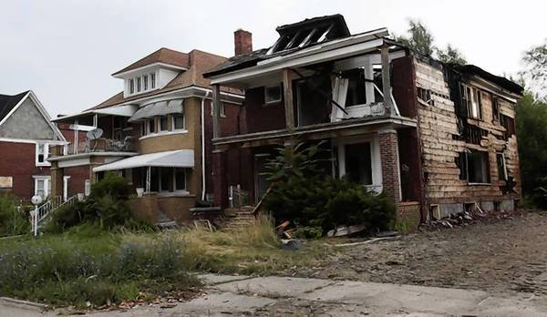
Structural Abandonment in the United States
Residential Properties Vacancy
7.4 million homes that are currently vacant and not being marketed for sale or rent in 2012 (The Joint Center for Housing Studies of Harvard University ).
nearly 40 percent of the nation’s vacant homes are located in just 10 percent of all census tracts (Duke 2012).
Source: http://articles.chicagotribune.com/2013-07-24/news/sns-rt-us-usa-detroit-blight-20130724_1_blight-removal-blight-problem-urban-blight

Slide 4
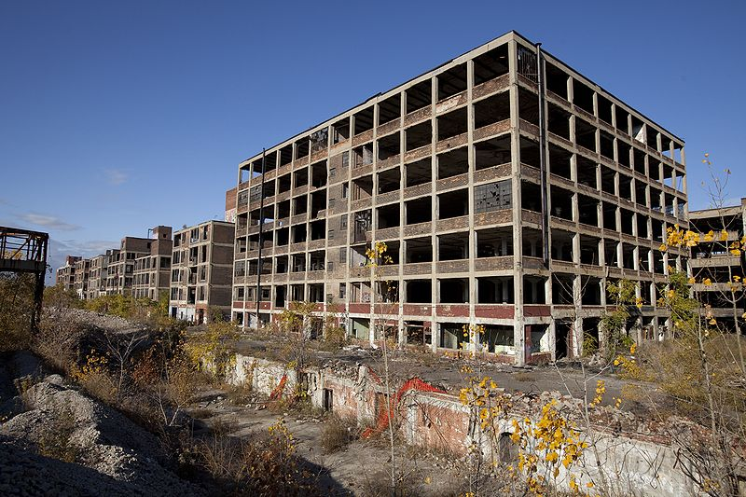
Industrial Sites Vacancy
Automotive and Autocaptive Plants (1979-2011)
 | United States | Michigan
In Operation | 180 | 65
Total Closed | 267 | 105
Repurposed | 132 | N/A
Remain Closed | 135 | N/A
Total Plants Constructed | 447 | 170
267 automotive plants have closed across the country, nearly 60% of the original 447 plants constructed since 1979.
22% of Industrial Zoned Land in Detroit is Vacant
Source: Burgeman, et al., 2011
Largest Abandoned Factory in the World
-- Packard's Detroit plant
opened in 1903 and closed in 1956
would cost over $10 million to raze it
Source: http://sometimes-interesting.com/2011/08/15/largest-abandoned-factory-in-the-world-the-packard-factory-detroit/
Notes:
Much of the available data regarding abandonment and vacant properties pertains to the City of Detroit. According to the Detroit Future City Project 36% of commercial properties are vacant and 22% of industrial zoned land is vacant.
The table on the right shows the number of automotive and autocaptive plants in Michigan and the United States that have been constructed and still remain in operation.
In Michigan only 65 of the 170 constructed plants, less than half, remain in operation in the State.
Michigan, however, is not the only place that has been left with closed auto plants.
The United States as a whole has seen 447 plants be constructed since 1979 and only 180 remain in operation today for their original purpose.
The US has seen about half of the closed plants go through transition to be repurposed for alternative manufacturing purposes.

Slide 5
Commercial Properties Vacancy
U.S. vacancy rate forecast for commercial property from 2012 to 2016, by type*
Source: United States; RREEF Real Estate, Deutsche Bank Group; IHS Global Insight; As of 2012
More than two dozen malls have shut down in the last four years and another 60 malls are on the brink of death (New York Times Report)
It is estimated in Detroit, Michigan that 36% of commercial properties are vacant (Detroit Works Project 2012)

Slide 6
Social, Economic and Environmental Consequences
Where substantial abandonment exists we also are likely to observe limited economic and social opportunity and an increase in poverty rates (Galster, 1995)
The concentration of abandonment can lead to a concentration of poverty which results in myriad other social negative indicators such as higher crime rates, poorer educational performance, increased single parent families (Orfield, 1997).
Foreclosure, Crime, and Unemployment Rates
City | Foreclosure Rates 2008 | Crime Index per 100,000 inhabitants 2008 | Unemployment Rate 16 year and older 2008
Detroit | 16.0% | 5,295 | 20.4%
Flint | 12.8% | 5,530 | 18.5%
Lansing | 9.3% | 2,938 | 9.6%
Grand Rapids | 8.0% | 3,050 | 9.4%
Ann Arbor | 4.1% | 1,241 | 6.0%
Source: (USA.com, 2008), (US Department of Housing and Urban Development, 2008), (United States Census Bureau, 2008)

Slide 7
Economic Impact of Blight
The full cost of demolishing an average residential property is around $10,600 (Geneses County Land Bank, Flint , Michigan)
The removal of all the currently estimated abandoned residential properties (7.4 million) could cost about 7.8 billion dollars
Abandoned properties inherently decrease the tax revenues available to public entities to support public safety, debt retirement, public works maintenance and other critical social needs.
The City of Detroit, Michigan filed for bankruptcy on July 2013. The city had been conflicting with deficits for ten years resulted from declining revenue.

Slide 8
Property Values Associated with Blight
450 feet
300 feet
150 feet
“on average, commercial and industrial properties near brownfields are 10% lower in property values” (Paul, 2008)
Property values within a 1.5 mile radius increase by at least 10% when a brownfield parcel is redeveloped (Paul, 2008)
Abandoned Property
Mean sales price:
$ 61,468
-$7,627
-$6,819
-$3,542
Source: Vacant Properties: the True costs to Communities, National Properties Campaign, August 2005
Notes:
The research conducted by National Properties Campaign analyzed all 14,526 residential sales in Philadelphia for greater than $1,000 during the year 2000, and the average sales price is $ 61,468. In this study, researchers from Philadelphia found that mean sales in houses within 150 feet of a vacant or abandoned property experienced a net loss of $7,627 in value. Properties within 150 to 300 feet experienced a loss of $6,819 and those within 300 to 450 feet experienced a loss of $3,542.

Slide 9
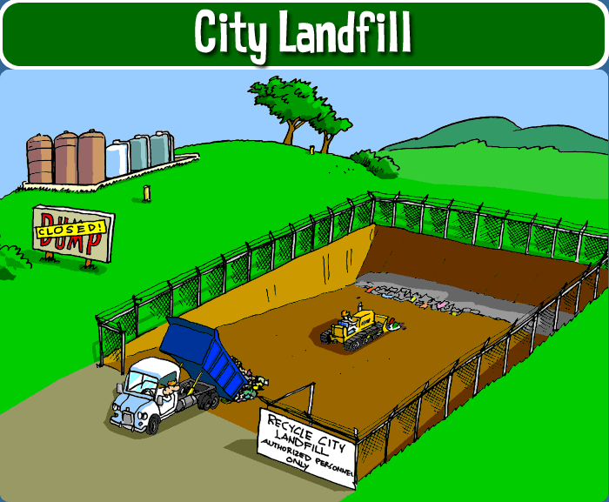
Environmental Impact of Blight
The US Environmental Protect Agency estimates that 136 million tons of construction and demolition waste are generated each year. This volume of waste constitutes approximately ¼ of all landfill waste.
Hazardous materials increase the potential for public health concerns and substantially increasing the public costs of demolition and clean up.

Slide 10
Current system of abandonment
Owner "walks away” from the structure
Local government left with the burden of eliminating the structure
Abandoned Structure becomes blighted
A cycle of community decline is set in motion
Taxpayers bear the cost of deconstruction
Private owner constructs Property
Notes:
This chart represents the current system of private property abandonment in Michigan.
First the private sector constructs and industrial or commercial property, then in the event that they private sector experiences some form of economic hardship they “walk away” from the structure and it is left as a vacant structure in the community. If this structure is not sold or repurposed, as many are not, it becomes blighted and a threat to public safety.
When a community becomes littered with these abandoned and blighted properties the local governments are left with the burden of eliminating these structures, and ultimately it is the general tax paying public that bear the cost of deconstruction. Which sets in motion general blight and decline.

Slide 11
“The owner of blighted property is morally blameworthy in a way that the owner of non-blighted property is not, namely because the owner of blighted property is imposing harm on neighboring properties” (Eagle, 2007)

Slide 12
Summary of our current situation
Legacy communities have a considerable amount of PRIVATE abandoned property
The abandonment is the result of current policies that encourages property owners to literally “walk away” from their parcels
Abandonment and blight set in motion negative social and economic consequences that lead to concentrated poverty, disinvestment and limited opportunities…..which add additional burdens to public entities
Private Property abandonment places unsustainable financial burdens on public resources/institutions and reduces the available financial resources critical public investments.
Blight and the demolition of abandoned structures increases landfill pressure, consumes natural resources and exposures hazardous materials

Slide 13
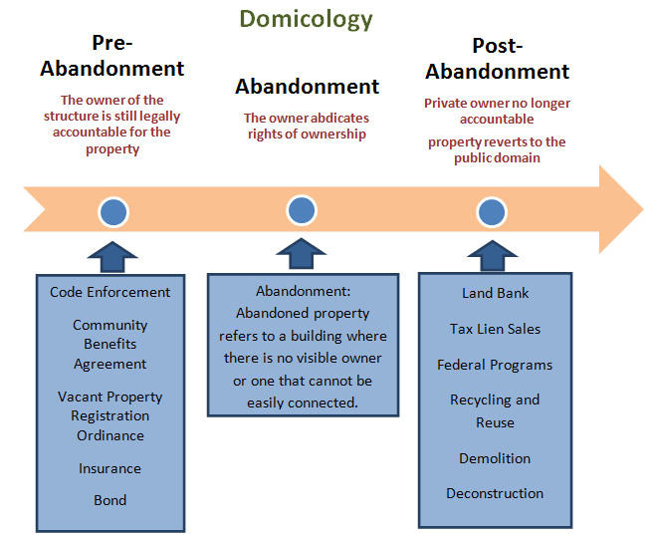
Domicology
Domicology is defined as: “The study of policies and practices of human structural abandonment”.
Coined as the study of “DOMICOLOGY”, the research team in collaboration with the Domicology Advisory Committee (DAC) proposes to examine the continuum of structural abandonment.

Slide 14
Current Practice in Removing Abandoned Structures
Pre-abandonment Strategies
Code Enforcement
Reduce the popularity of blight structures
Responsible for investigating complaints related to properties from residents or business and regulating the building code violation
Vacant Property Registration Ordinance
The VPROs require property owners to register vacant and foreclosed properties with the local government.
Community Benefits Agreements
Secures the community against “dark store” phenomena
legally enforceable contracts between a developer (i.e. a private business), the local government, and community organizations and residents (Marcello 2007).
Notes:
In the City of Trenton, Ohio, the VPROs requires owners of real property to register all property within 30 days of the vacancy and they are required to renew registration annually A registration fee is often collected to maintain and secure properties for a specific period of time. Properties owner are typically required to carry a minimum amount of insurance or to provide a minimum bonds or deposits.

Slide 15
Post-abandonment Strategies
Lank Bank
Land Banks are public or community-owned entities that are developed for the purposed of acquiring, managing, maintaining and repurposing vacant, abandoned and foreclosed properties.
According to the he research conducted by the Center for Community Progress in 2014, there are approximately 120 land banks and land banking programs throughout the country. The top three states with largest number of land banks are Michigan, Ohio and Georgia.
Land bank inventories vary greatly. Inventory sizes range anywhere from a few properties to thousands of properties (in spring of 2014, the Genesee County Land Bank had an inventory of approximately 11,000 properties).

Slide 16
Federal Programs for Blight Elimination
The Community Development Block Grant
(CDBG)
Neighborhood Stabilization Program (NSP)
U.S. Department of Housing and Urban Development
(HUD)
The private property abandonment is classified as Community Planning and Development Program under HUD
The CDBG is one of the oldest and continuously running HUD programs.
In the fiscal year 2015, HUD is requesting $2.8 billion for CDBG
The NSP is a component of CDBG.
There are three rounds of HUD’s NSP. In total, the program appointed $7 billion funding to support state and local governments
A federal financial program to deal with housing crisis
In 2010, the HHF provides $7.6 billion to the hardest hit states (including Michigan).
Hardest Hit Fund (HHF)
Notes:
The Department of Housing and Urban Development (HUD) is a federal government agency that was created in 1965, which aims to increase homeownership, support community development and increase access to affordable housing free from discrimination (HUD).

Slide 17
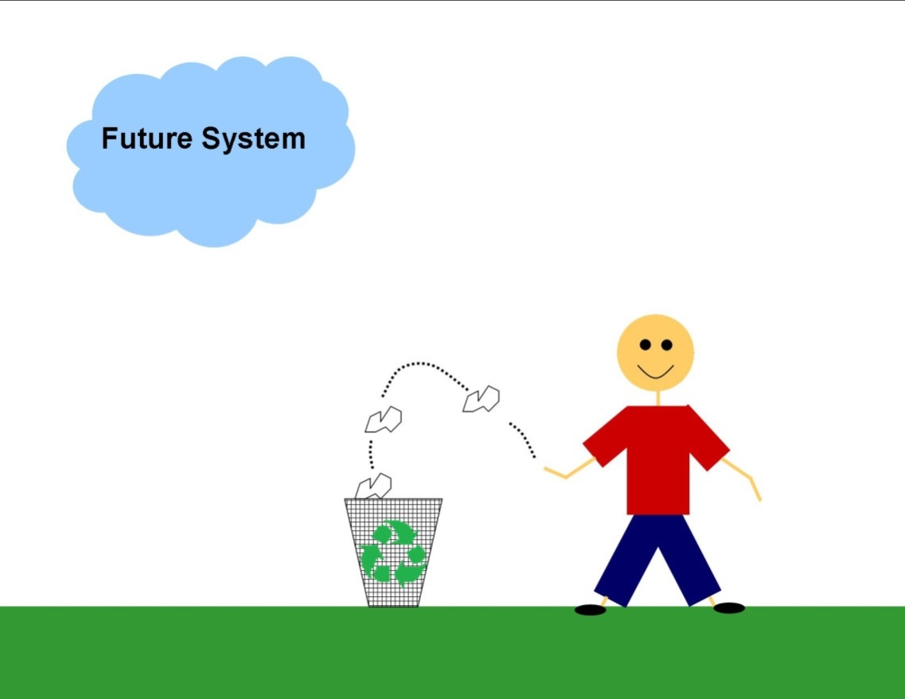
Rethinking our current Paradigm
Notes:
The question now becomes how do we prevent the continual cycle of abandonment. While action should be taken to address the currently vacant properties our research searches for a method to end the cycle. There are currently several industries that are already engaging in preventative and proactive measures to ensure proper deconstruction at the end of the useful life of the structure such as:
Surface Mines
Electricity Generating Wind Turbines
Land Fills
Oil Rigs
Cellular Towers

Slide 18
U.S. Precedents in Financial removing Abandoned Properties
Industry | Policy
Cellular Towers | Local ordinances require a performance bond to ensure the decommissioning of the tower
Electricity generating wind turbines | Operator must post performance bond for deconstruction at the issuance of the permit
Landfills | Natural Resources and Environmental Protection Act - perpetual care fund for their closure and monitoring for the 30 years after they cease operation
Oil Rigs | The US Bureau of Safety and Environmental Enforcement requires the plan for decommissioning at the time of the initial Right-Of-Way or Right-Of-Use-and-Easement
Mining Reclamation | Surface Mining and Reclamation Act (SCMRA) of 1977
Trans Alaska Pipeline System | Requirements for the dismantling, removal, and restoration are outlined in the grant and lease agreement with both the federal and state governments

Slide 19
Alternative Approaches in Financial removing Pre-Abandoned Properties
We examined two possible methods:
Bonding
Insurance
Notes:
.

Slide 20
Bonds
Developer purchases the bond and it is secured with the local government entity for the cost of deconstruction
Cost of the bond can be assessed at the time of final building inspection.
The bond will be necessary for the issuance of the occupancy permit.
This practice may already be feasible under the Performance Guarantee Act of the Michigan Zoning Enabling Act of 2006 and could be implemented at the local level through local zoning ordinance
Notes:
.

Slide 21
Two related bonds
Dark Store Ordinance – Oakdale, CA
allows the city to require that developers of retail stores larger than 40,000 square feet obtain and carry a performance bond that will cover the city’s cost of demolishing.
Dark Store Ordinance – Wauwatosa, WI
adopted a big-box ordinance that requires new retail stores over 50,000 square feet contribute 20 cents per square foot of building’s total size to the city’s Land Conservation Fund before the city will grant them a building permit. The fund can be used to redevelop the site if the building is vacated.
Sources: http://www.ilsr.org/rule/preventing-vacant-boxes/2299-2/ http://www.ilsr.org/rule/preventing-vacant-boxes/2298-2/
Notes:
Dark Store Ordinance:
Time Limitation: If the facility is vacated, the owner or operator, within twelve months, shall submit to the plan commission, a plan contemplating the removal or reuse of the facility.

Slide 22
Insurance Policy
Property owner purchases insurance to cover cost of potential dismantling, removal, and restoration, environmental damage, and threats to public safety and health
The Policy is in effect for the entire lifetime of the structure
This initiative may require State/Federal legislative action.
Industries such as the railroads purchase a similar form of insurance through a variety of agencies -AIG, Zurich, and Arcadis

Slide 23
Estimating Cost (for bond or insurance)
Variables include:
Type of buildings(industrial, commercial, or residential property)
Size of buildings(# of stories, length, width, etc.)
Length of occupancy
Site location and nearby buildings and infrastructure
Nature of construction materials in building
Environmental and Safety requirements and restriction
Value of salvage(equipment salvage, useful materials)
Local/Regional Deconstruction Industry Capacity

Slide 24
Cost Estimate of Commercial Property Insurance Premium
Avg. # of floors : 1
Avg. size: ≈ 6500 sq. ft.
Average lifetimes: ≈ 30 yrs.
Est. Deconstruction cost: ≈ $10 per sq. ft.
Building Energy Data Book and Pacific Northwest National Laboratory(PNNL), average commercial property characteristics
Estimated insurance monthly Premium:
Pm=CD/T =(Csf*S)/T
=($10*6500 s.f.)/30/12
≈$180 per month (minus value of salvage)
Pm : Insurance monthly payment
CD: Deconstruction cost for whole building
Csf: Deconstruction cost per square feet
S: Floor space Sq. Ft.
T: Length of occupancy Yrs.
Notes:
The data of commercial building floor space and number of buildings come from PNNL(Pacific Northwest National Laboratory)
The data of commercial building lifetimes come from EIA (Energy Information Administration): Assumption for the Annual Energy Outlook

Slide 25
Bonds vs. Insurance Commercial and Industrial new construction ONLY
Bonds
Insurance
Can do it Now !
Relies on Govt. Estimation of Costs
One time costs estimation (at point of occupancy)
Front Loads development costs
Potential diversion of funds to other needs (politics!)
Will require legislative leadership
Relies on Private sector estimation and monitoring of costs
Can be adjusted over lifetime use of building
Spreads costs over lifetime
Creates new employment sector

Slide 26
Insurance Possible Advantages
Require the deconstruction of abandoned properties—END BLIGHT
Encourage the use of recyclable/reusable materials
Promote a more sustainable system of construction and deconstruction
Financial responsibility lies with consumer and reduce public subsidy of removal
May encourage redevelopment of existing abandoned parcels (if applied to only new construction)
All communities would be equally impacted (assuming national legislative leadership)
Create new insurance/deconstruction sector THAT MONITORS SITE PERFORMANCE AND ADJUSTS PREMIUMS ACCORDINGLY

Slide 27
Insurance Possible Disadvantages
May encourage low cost building practices
May increase the short-term cost of construction
Increase price to consumer by eliminating hidden public subsidy
May discourage mixed-use structures
If enacted only at the local level it may increase competition for economic development…come abandon in our town!

Slide 28
Requiring all new construction to be built for deconstruction
Deconstruction is the process of the selective dismantling or removal from building components in order to make the maximum use of recycled materials (U.S. Department of Housing & Urban Development, 2000)
Benefits of Deconstruction
Reduction in waste generation and conservation of local landfill space
Creating job training and employment opportunities
Reduce local energy consumption and natural resources
Providing materials for building construction
Overall lower building removing costs – because the added value of material salvage and avoid disposal costs

Slide 29
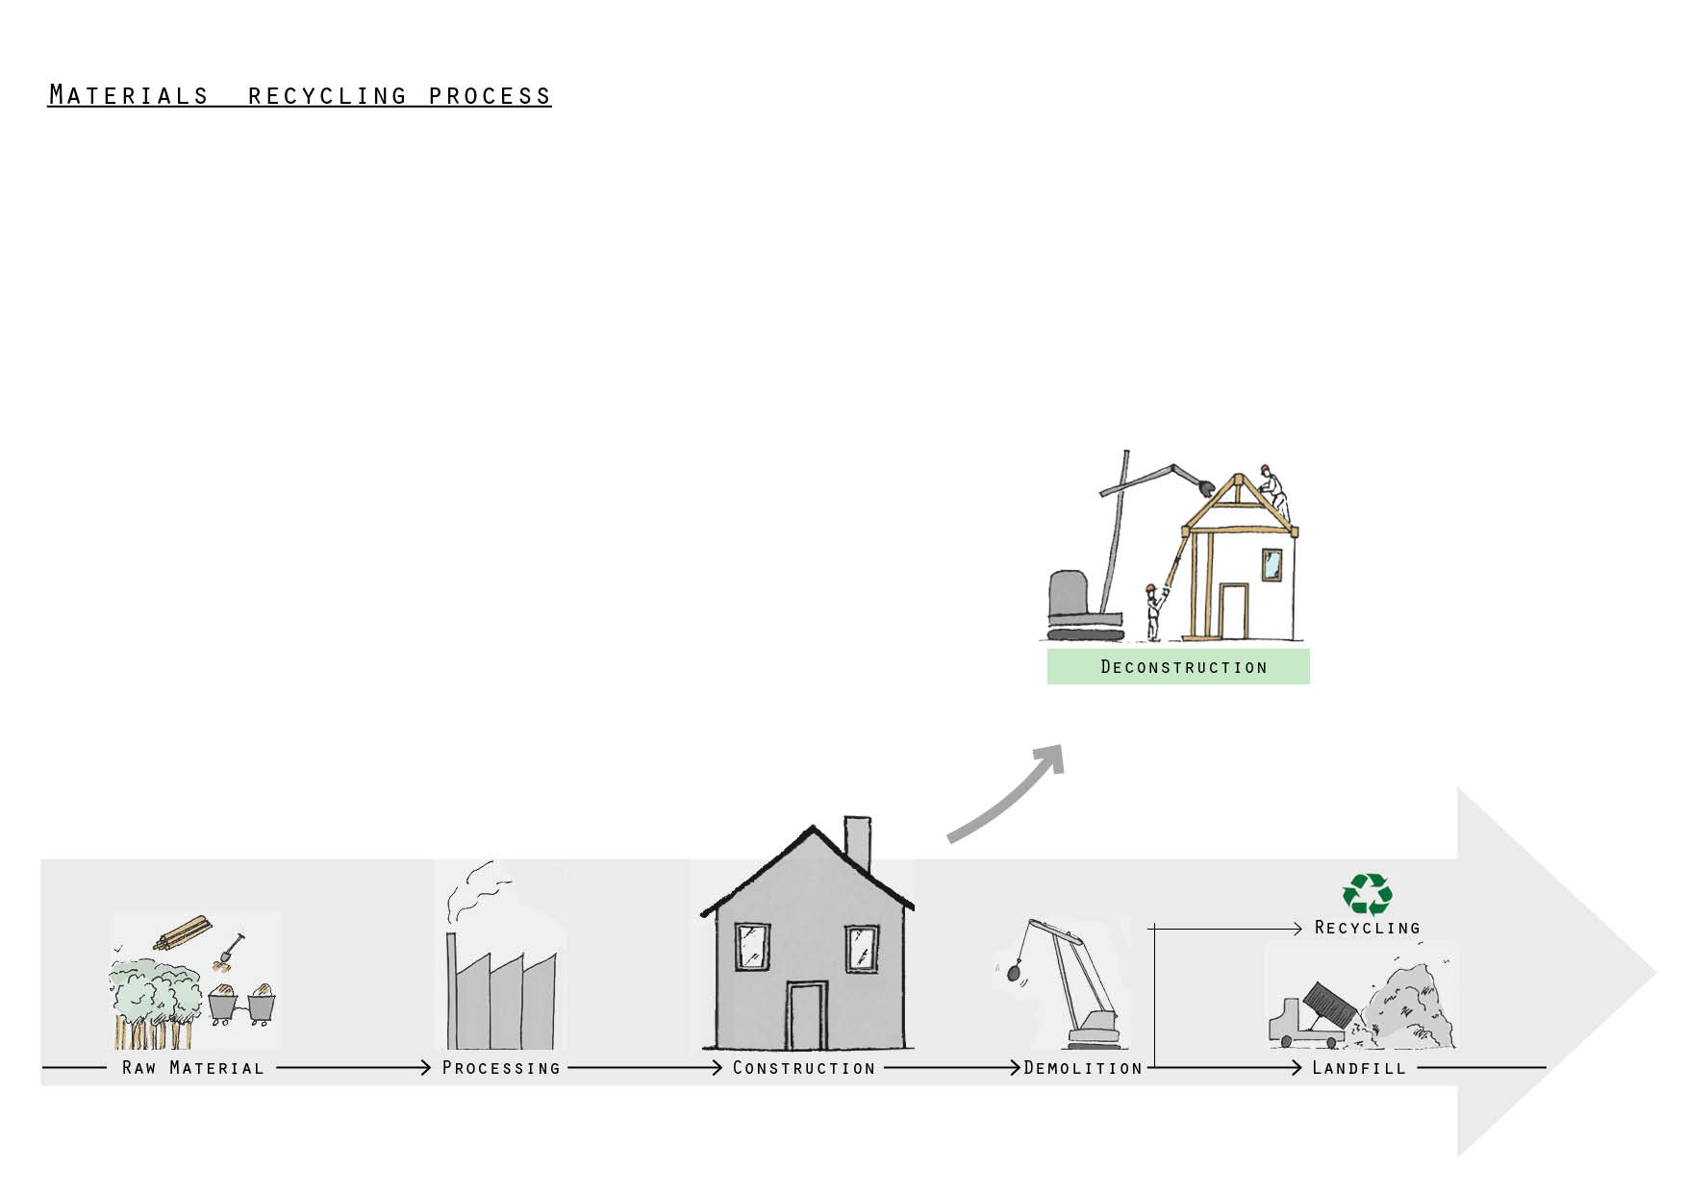
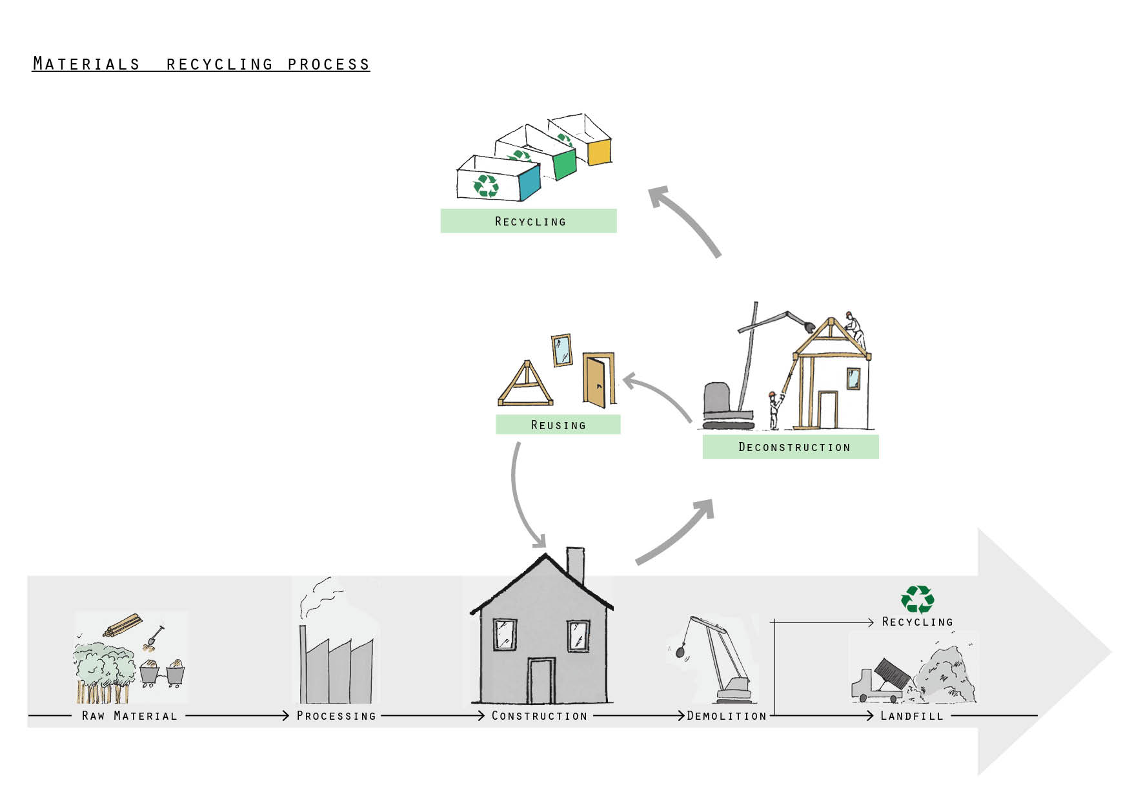
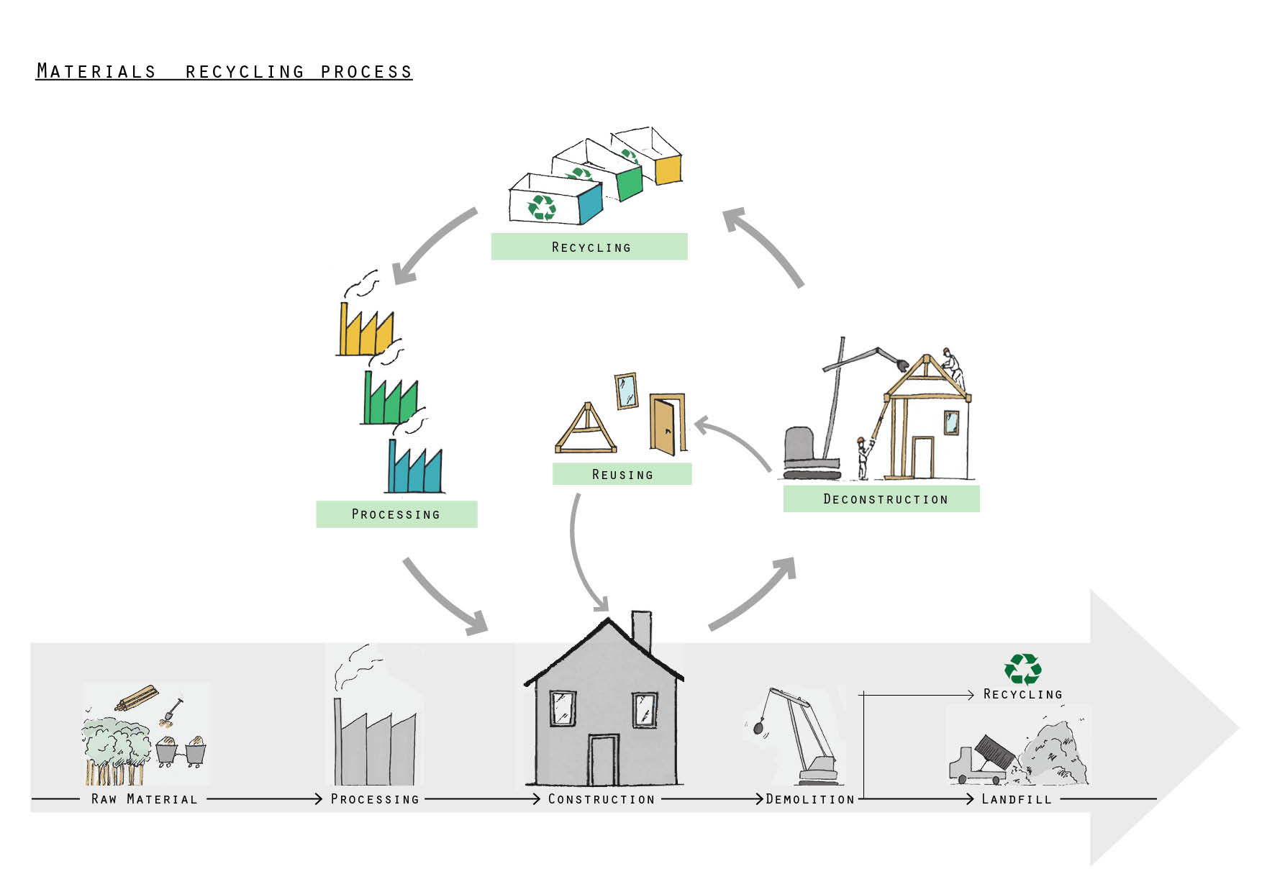
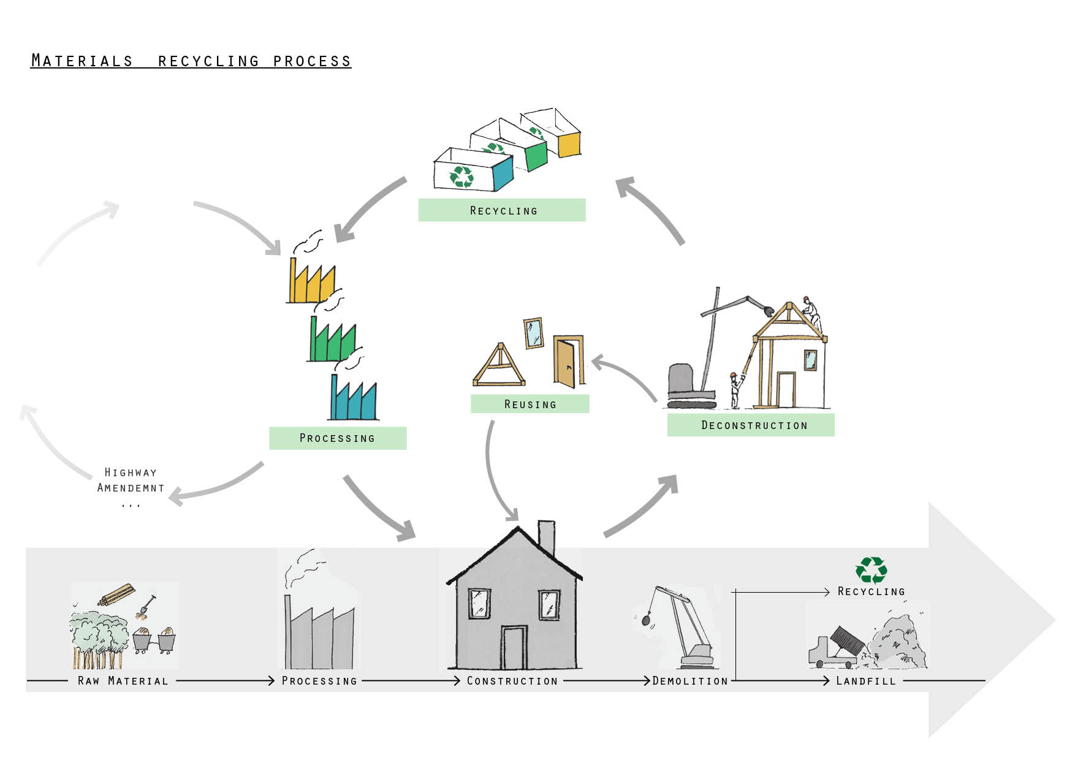

Slide 30
The Alternative Paradigm
Private Sector constructs facility and incorporates in business plan cost to fund deconstruction
Private Sector ends business operations at the facility
The parcel is returned to the original state
Blight prevented!
Abandoned structure deconstructed with funds from the insurance
The consumer assumes cost of deconstruction
NOT GENERAL TAXPAYER!

Slide 31
Future Research
“National Abandoned Structures Task Force”
What local, state and national policies and practices encourage private structural abandonment?
What is the feasibility of adopting policies and practices such as bonds, fees, and structural insurance policies that would provide for the financing of deconstruction of abandoned private structures?
What polices could promote the structural deconstruction over demolition?
What factors may determine a region’s competitive advantage to engage widespread deconstruction?
What economic development policies, models, tools and practices might assist in the creation of a structural deconstruction economy?
What is the potential impact of a deconstruction sector on employment? What occupational training is necessary for these occupations and what is the current capacity to provide this training?

Slide 32
Future Research
What research is needed to convert low value, high volume construction and deconstruction wastes into high value commodities and products?
What are the short and long-term risks associated with deconstruction of potentially toxic structural materials and what methods might be employed to reduce or eliminate these hazards from the reuse stream?
What is the life cycle impact of such material conversions and applications? What is the life cycle impact of demolition vs. deconstruction, generally? This should include traditional Life Cycle Analysis (LCA), energy flows, and embodied energy.
What are the areas of intersection between offsite construction and deconstruction activity/salvaged materials? Is there a role for redevelopment of legacy cities?
What is the impact of deconstruction and design for deconstruction on contractors? Contract terms and specifications? Information flow? Training? Schedule/cost? Construction techniques? Safety/risk?

Slide 33
Private Property Abandonment
https://www.facebook.com/pages/Private-Property-Abandonment/753304658021811

Slide 34
Contact us with further questions
MSU Center for Community and Economic Development
1615 East Michigan Avenue
Lansing, Michigan 48912
(517)353-9555
www.cced.msu.edu
Special thanks to:
Mengqiu Wu MSU CCED Research Assistant
Emily Bank MSU CCED Research Assistant
Michelle LeBlanc University of Georgia, Master Student
George Berghorn MSU CCED Research Assistant
Lorraine Valembois MSU CCED Research Assistant
Notes:
.

Slide 35
Comments?
Notes:
.

